Slide 1

Deployment

Slide 2
Objectives
Discuss deployment options for chatbots built with Watson Assistant
Deployment

Slide 3
Introduction
Integrations are one of the easiest way to deploy your Watson Assistant chatbot.
There are several other integration channels available, including Facebook Messenger, Slack, and Intercom (Plus and Premium user)
Watson Assistant as the conversation engine as opposed to the interface itself.
Deployment

Slide 4
Introduction
The user will be able to type in their message in Facebook Messenger
That input will be sent to Watson Assistant, who will provide a response and send it back where Messenger will ultimately display it to the user.
So you could have the same assistant deployed over multiple channels, allowing users to interact with the same “engine” from different interfaces.
Deployment

Slide 5
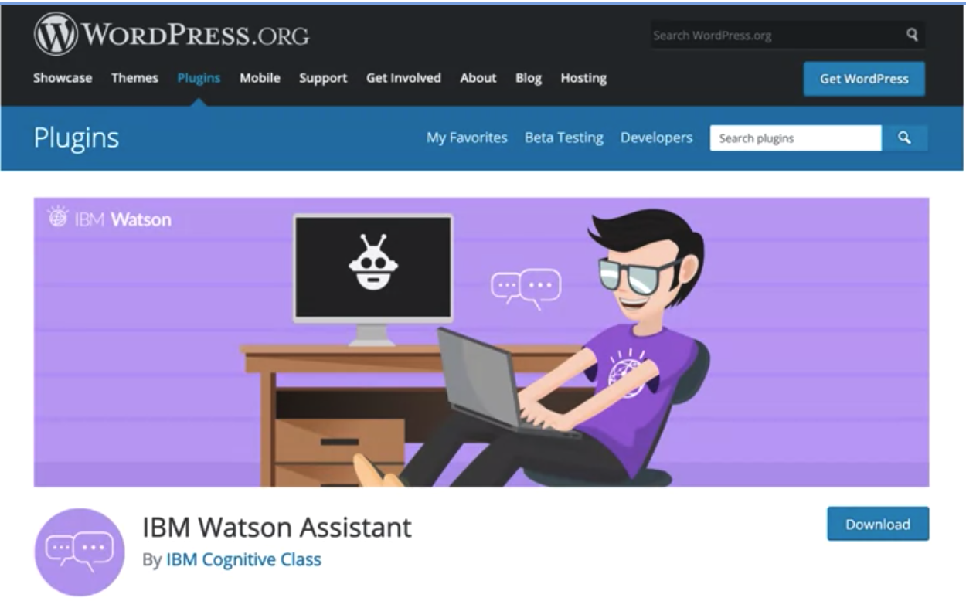
Introduction
We have a few more options to deploy assistants
  Custom Application
  Voice Agent (Telephony)
  WordPress plug-in: simple to deploy your chatbot
Deployment

Slide 6
Introduction
Deploy your chatbot to an interface or messenger:
  Watson Assistant is available through an API.
  You just need a proxy application that acts as an intermediary.
  This application will collect input from the interface
  Send it to Watson Assistant through an API call.
  Once a response is obtained, the proxy app will send it to the interface to display it back to the user.
Deployment

Slide 7
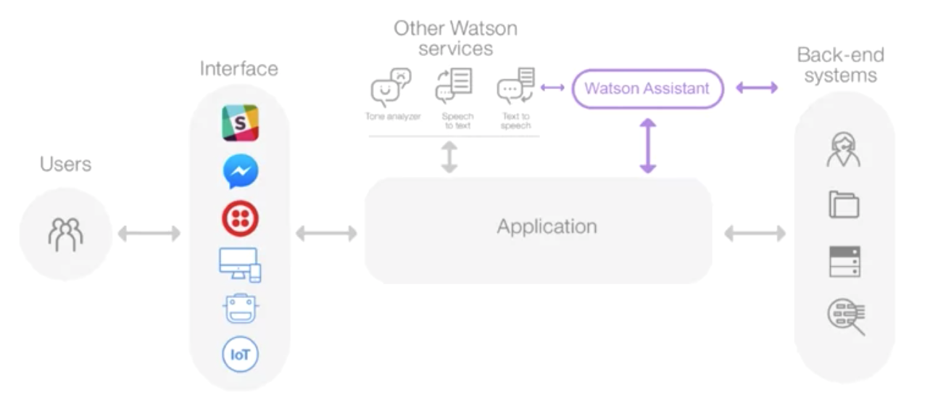
Introduction
Deployment

Slide 8
Deploying to Facebook Messenger
Steps:
  1. Create a Facebook Account, Page and App
  2. Setting App Secrect for Facebook app
  3. Generate the Page Access Token for your Facebook page.
  4. Integrate your Facebook App with Watson Assistant
Deployment

Slide 9
Deploying to Slack
Steps:
  1. Create a Slack Account App
  2. Add permissions
  3. Verification Token
  4. Integrate your Slack with Watson Assistant
Deployment

Slide 10
Summary
Discuss deployment options for chatbots built with Watson Assistant
Deployment

Slide 11
Q & A
Deployment

